Slide 1
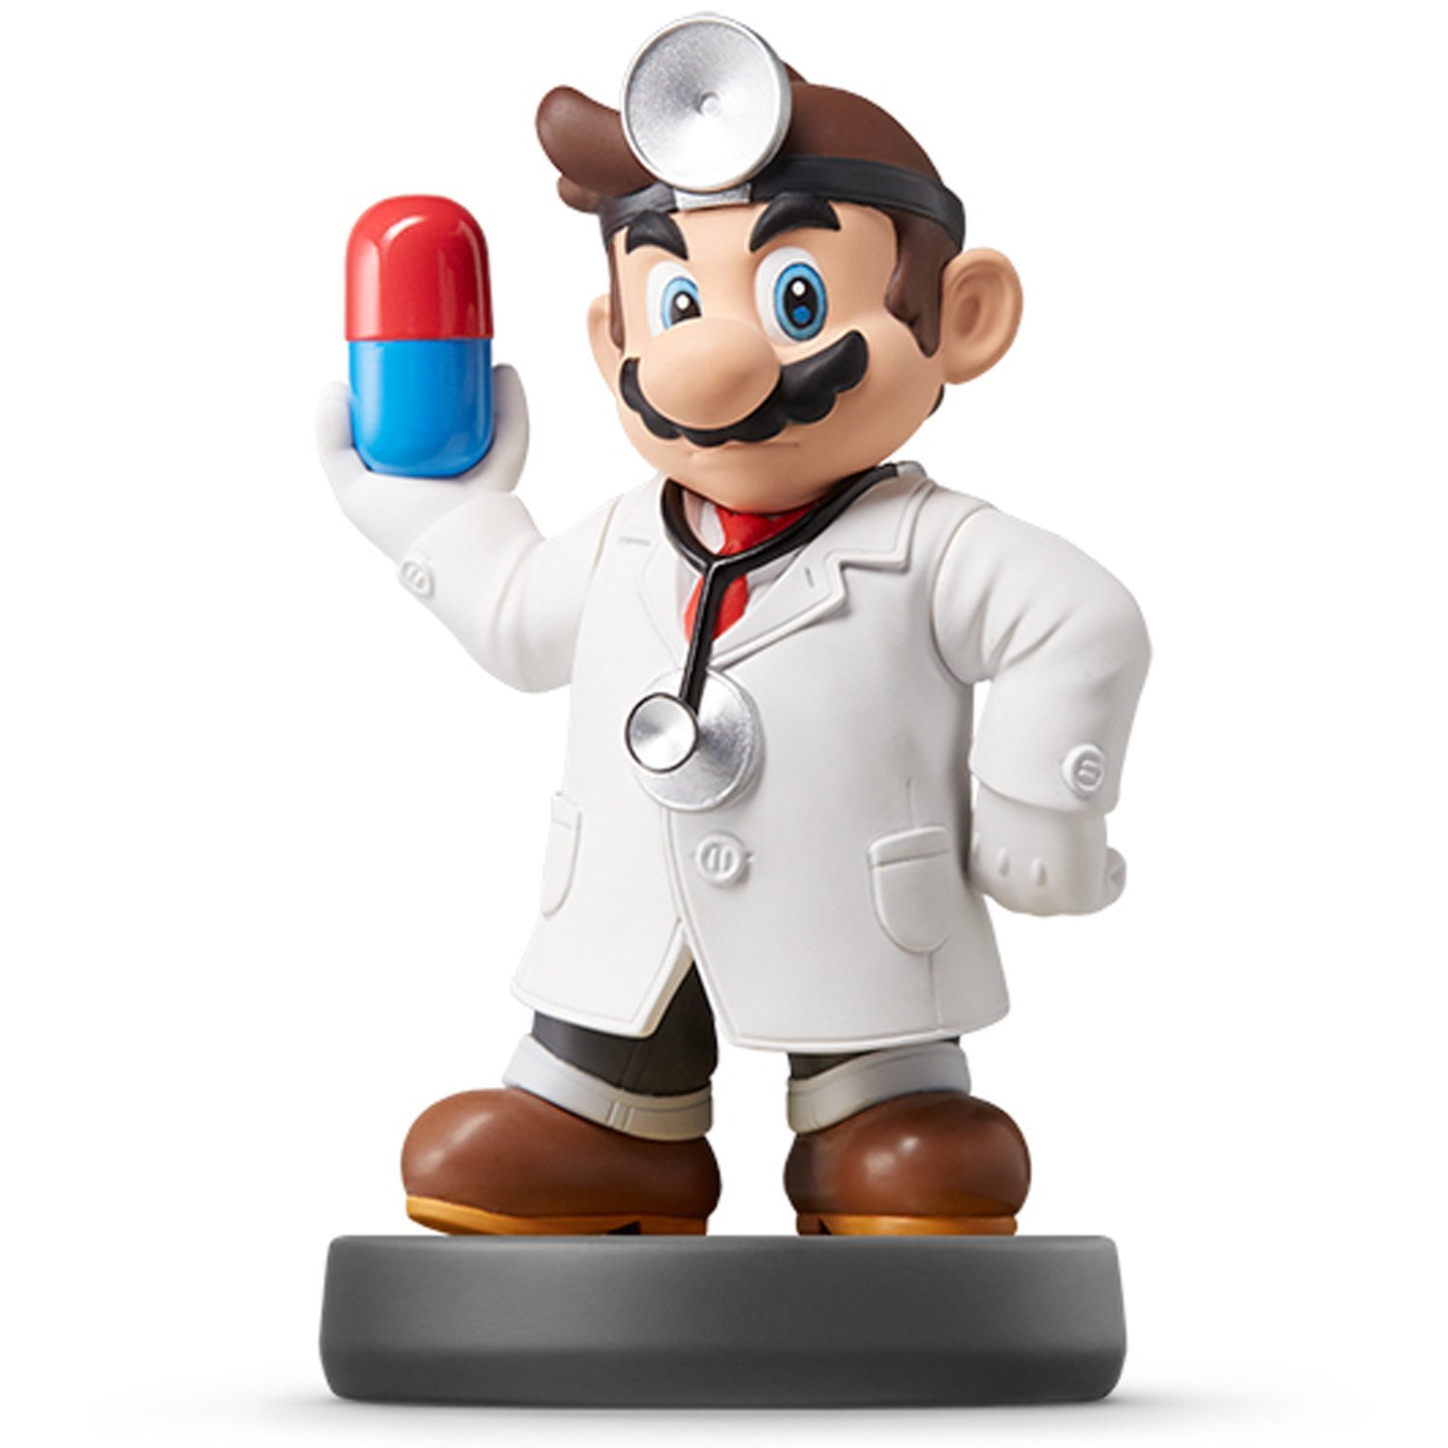
Data Transformation II

Slide 2
Data Transformation II Info
Tutorial II
Practice
filter()
arrange()
select()
mutate()
Introduced
Piping %>%
group_by()
summarize()
Chain of Command
Google -> Friend -> Instructor

Slide 3
Closing?
Disperse and Make Reasonable Decisions

